Slide 1
1. Installing QGIS (MacOS)

Slide 2
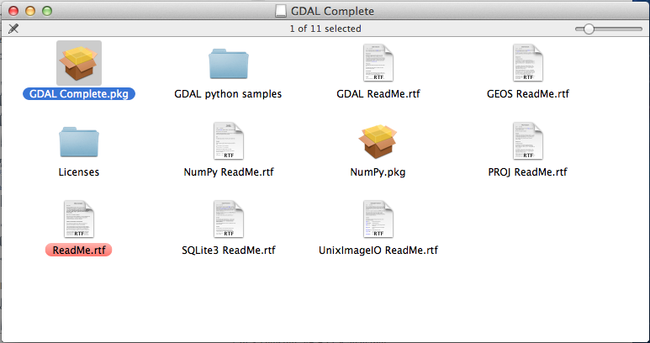
1. Install GDAL Complete

Slide 3
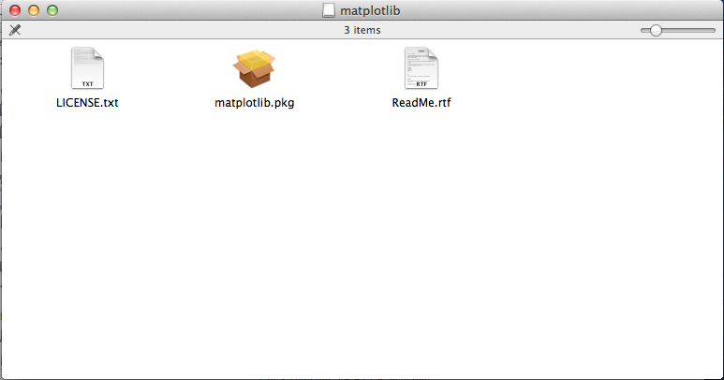
2. Install matplotlib

Slide 4
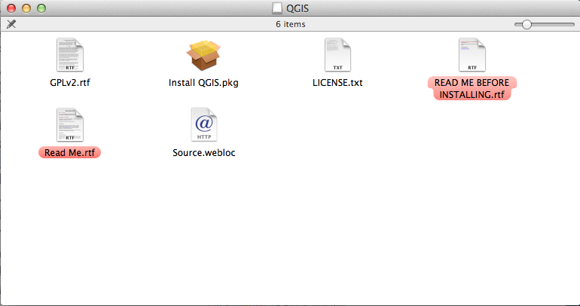
3. Install QGIS

Slide 5
1. Installing QGIS (Windows)
(just double click on the file: QGIS-OSGeo4W-2.6.1-1-Setup-x86_64.exe, no need to install the extra datasets)

